Slide 1
Orchestrate Redshift ETL using AWS glue and Step Functions
G.Bandhavi
2000030350
Sec : 14

Slide 2
Glue :
AWS Glue is a serverless data integration service that makes it easier to discover, prepare, move, and integrate data from multiple sources for analytics, machine learning (ML), and application development.
Step Functions :
AWS Step Functions is a visual workflow service that helps developers use AWS services to build distributed applications, automate processes, orchestrate microservices, and create data and machine learning (ML) pipelines.
Redshift :
Amazon Redshift is a fully managed, petabyte-scale data warehouse service in the cloud. Amazon Redshift Serverless lets you access and analyze data without all of the configurations of a provisioned data warehouse.

Slide 3
Here's an overview of how you can orchestrate Redshift ETL using AWS Glue and Step Functions :
Create an AWS Glue Crawler: A Glue crawler automatically discovers and classifies your data. Create a crawler to crawl your data sources and generate a table definition in the AWS Glue Data Catalog.
Create an AWS Glue Job: A Glue job is used to run ETL scripts and transform data. Create a Glue job that loads data from your source data store, transforms the data as necessary, and writes the data to your Redshift cluster.
Create an AWS Step Function: A Step Function is a serverless workflow service that allows you to coordinate the components of your application into a series of steps. Create a Step Function that invokes the Glue job created in the previous step.

Slide 4
Define a Step Function State Machine: Define the sequence of steps that the Step Function will execute, including invoking the Glue job, monitoring its progress, and handling any errors.
Trigger the Step Function: Trigger the Step Function manually or automatically based on an event such as new data arriving in your source data store.
Monitor the ETL Process: Monitor the progress of your ETL process using AWS CloudWatch Logs and Metrics.

Slide 5
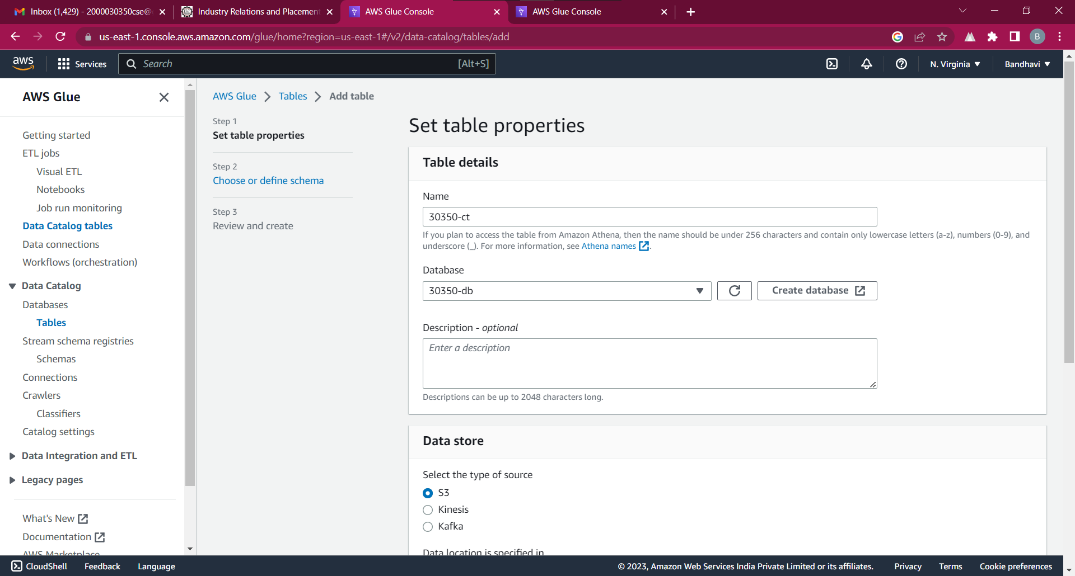

Slide 6
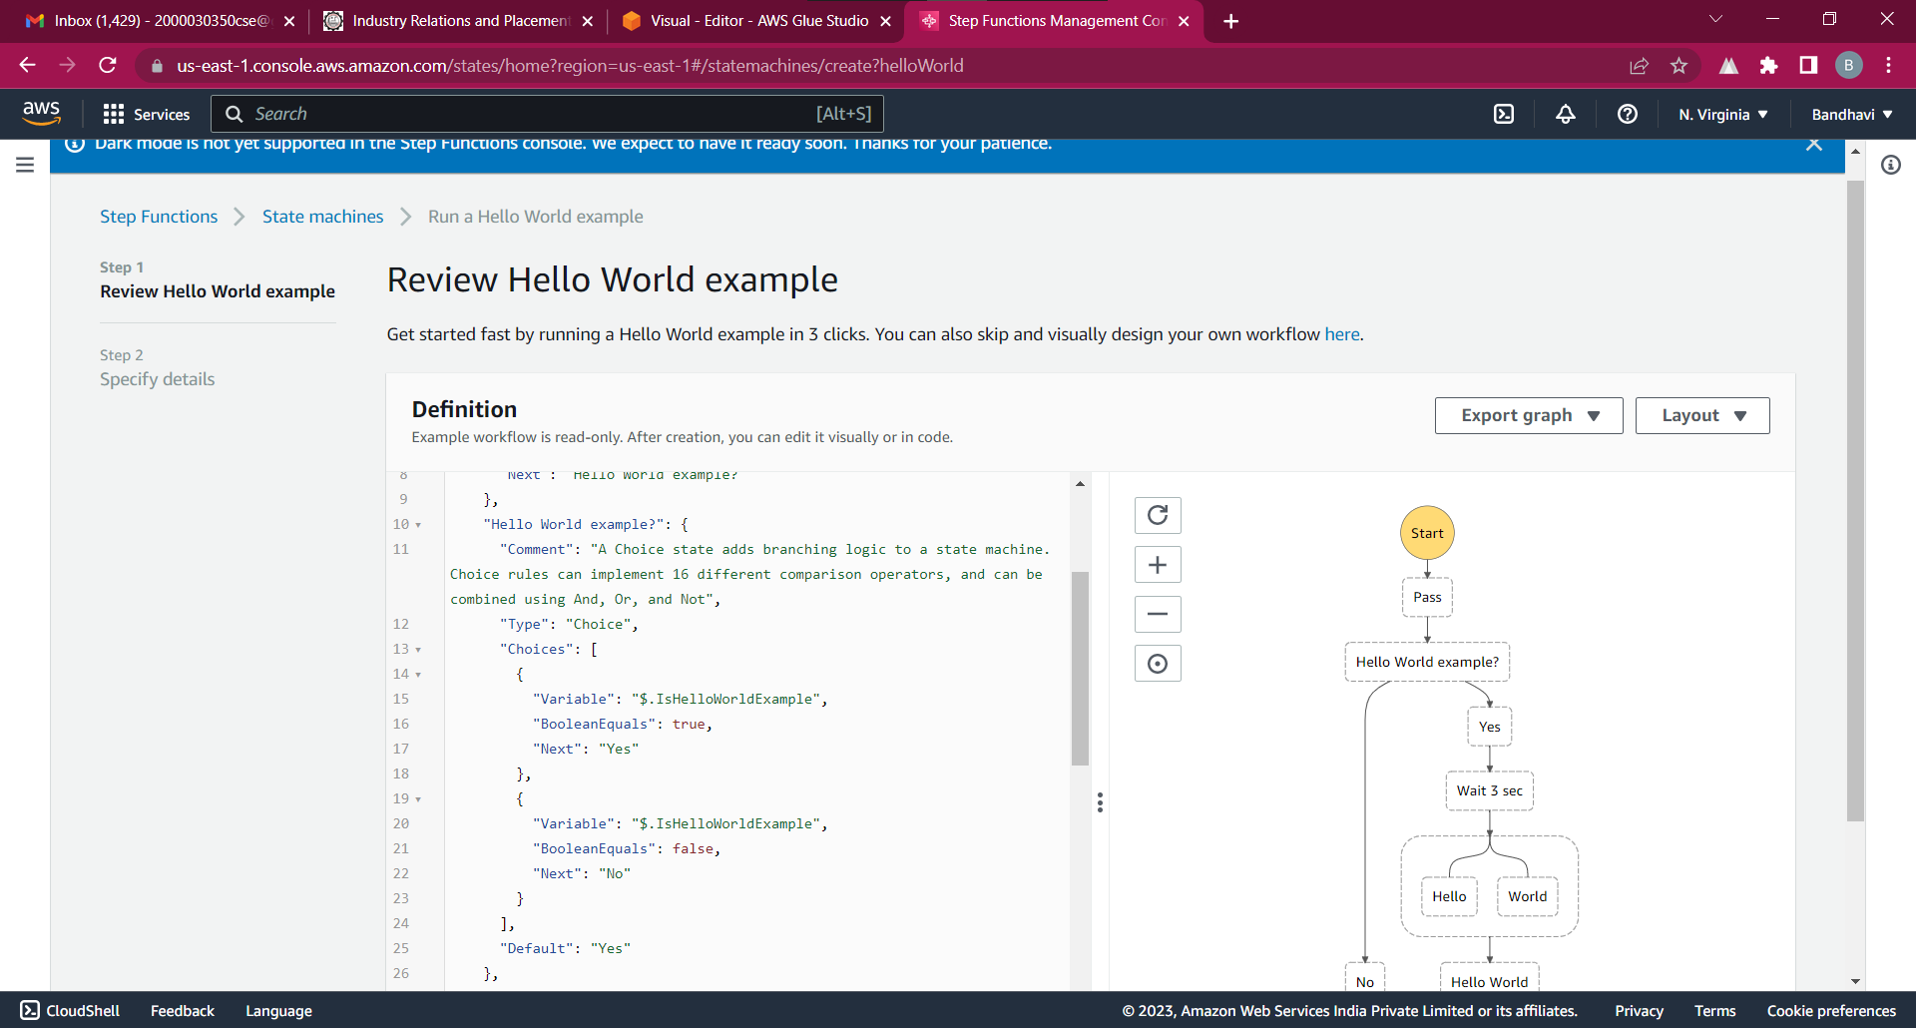

Slide 7
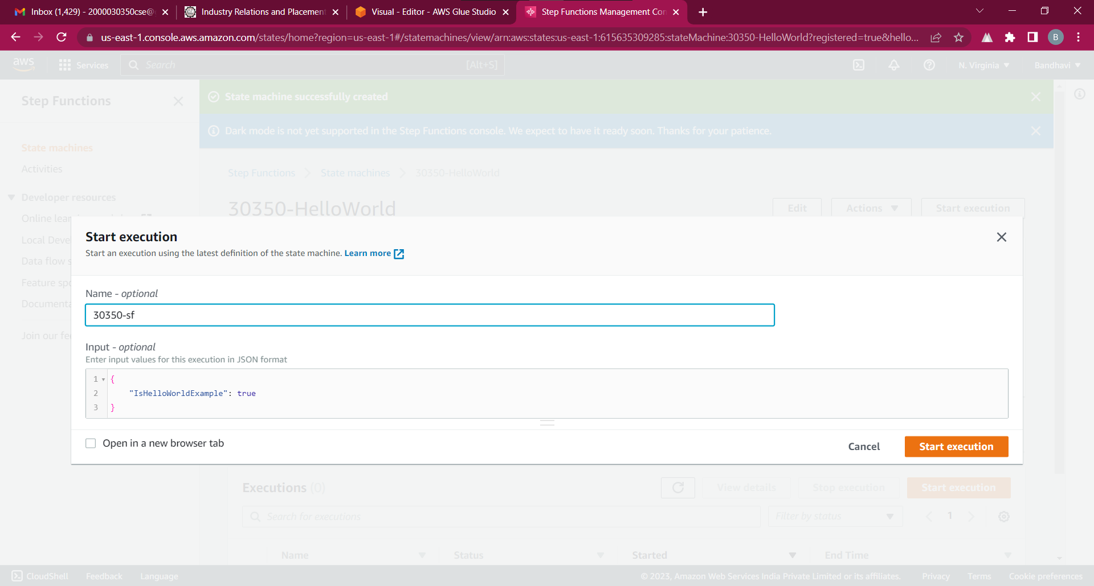

Slide 8
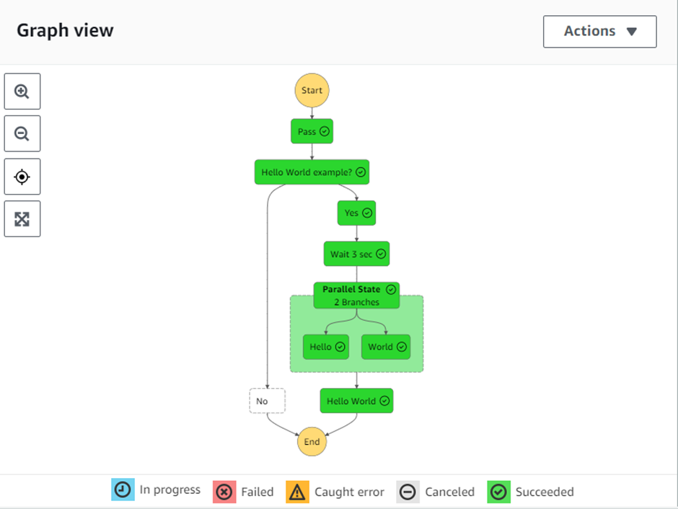

Slide 9
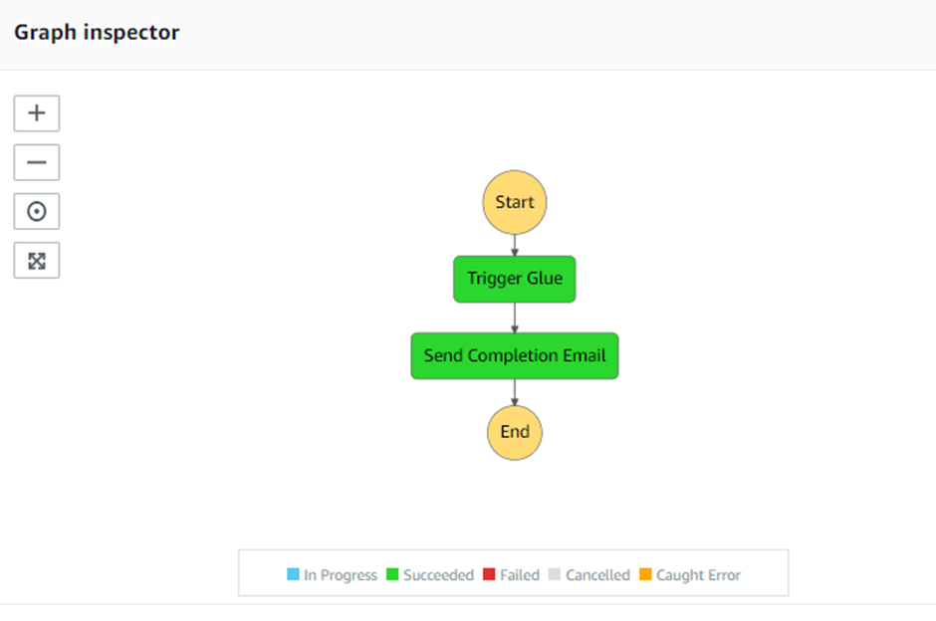

Slide 10
